Slide 1
Welcome back! Phones up

Slide 2
Are these people doing work?

Slide 3
Are these people doing work?
Maybe, maybe not because you can’t tell in a photo if there is any displacement

Slide 4
https://www.youtube.com/watch?v=fpnG3pRUglo
Is work being done in the video?
Can you tell if there is a displacement?
Is there a force?

Slide 5
EQUATION
$W=F∙d$
W = work
F = force
d = displacement
Work is equal to force times displacement
Work cannot be done without a change in position (displacement).
Work is done when the direction of the force and the motion are parallel.

Slide 6
Definition of Work
In physics, work is defined as:
1. “A force acting upon an object causing a displacement of the object”

Slide 7
Definition Continued: SUPER IMPORTANT TO KNOW
Work Definition:
2. Work → force is parallel to the displacement.
A force only does work on an object if a portion of the force is parallel to the displacement of the object (i.e., the direction the object is moving).

Slide 8
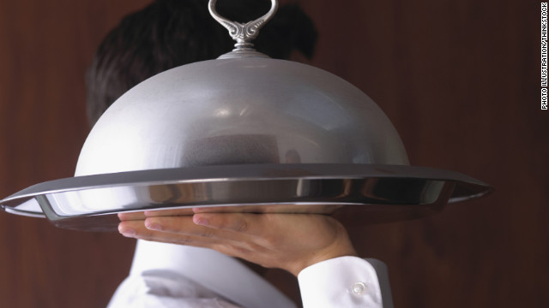
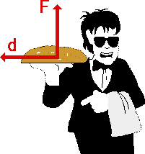
Is work being done?
A waiter carries a tray full of meals above his head by one arm across the room at constant speed.
Work is NOT being done. The force (normal
force on tray) is not parallel to the
displacement.

Slide 9
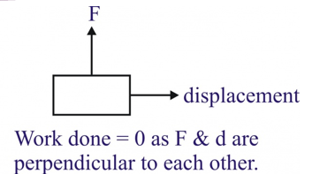
Is work being done?
A teacher carries a book across the room.
Work is NOT being done. The force (normal
force on the book) is not parallel to the
displacement.

Slide 10
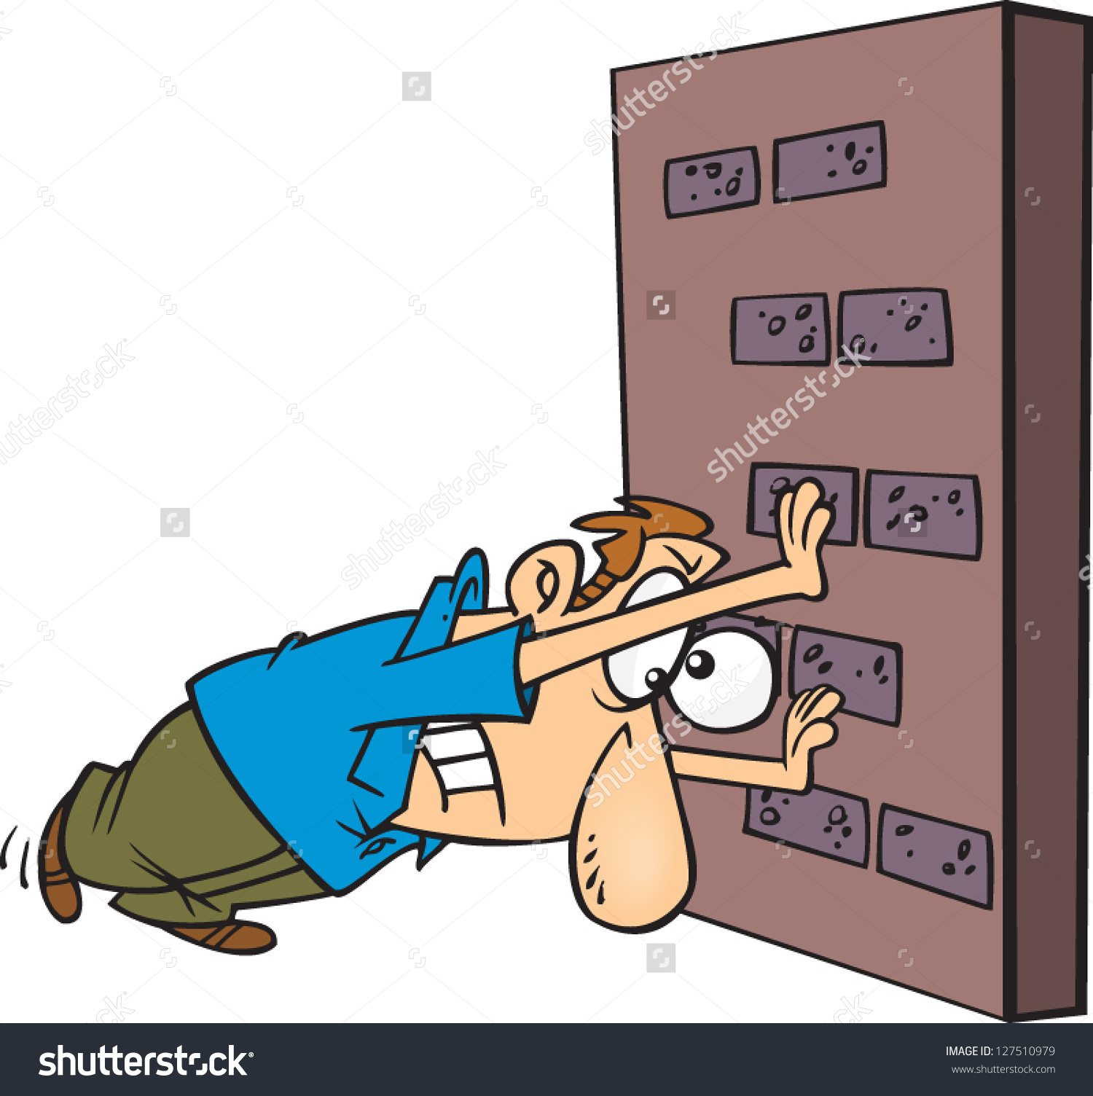
Is work being done?
A teacher applies a force to a wall and becomes exhausted.
Work is NOT being done…the wall
is not being displaced.

Slide 11
Is work being done?
A book falls off a table and free falls to the ground.
Yes, work is being done. The book is
being displaced by a force (the force due to gravity).

Slide 12
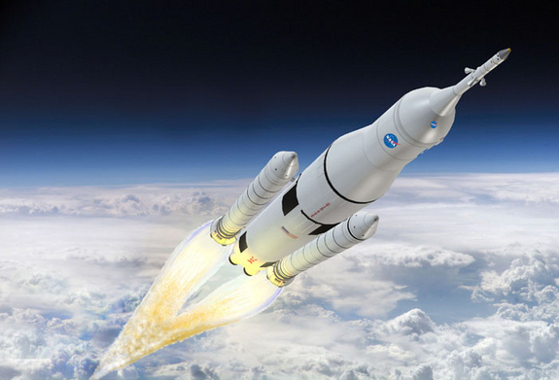
Is work being done?
A rocket accelerates through space.
Yes, work is being done.

Slide 13
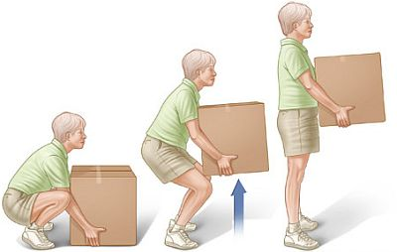
Is work being done?
Jimmy picks up a heavy box.
** The force used to pick up an object is equal to its weight: F_{w}=mg **
Yes, work is being done. The force and displacement are parallel

Slide 14
The Equation
W = work
F = force
d = displacement
$$W=F∙d$$
Units: Newton x meter = Joule (J)
** The force used to pick up an object is equal to its weight: F_{w}=mg **

Slide 15
Calculations
Jimmy picks up a box with a mass of 12 kg. If he lifts the box to a height of 0.7 m, how much work has he done lifting?
1. First find the force needed to pick up the box:
F_{w} = mg = 12 $∙$9.8 = 117.6 N
2. Find the work done:
$W=F\text{w}∙d$
$W$= 117.6 $∙$ 0.7
$W$= 82.32 J

Slide 16
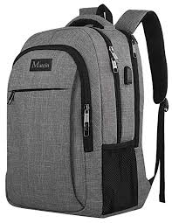
practice
A 5 kg backpack is lifted 2.0m. How much work is done?

Slide 17
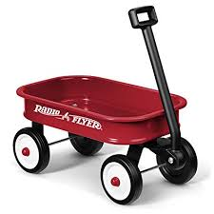
practice
A wagon is pulled a distance of 75 meters across the grass. The wagon is pulled with a constant force of 25 N. How much work is done?

Slide 18
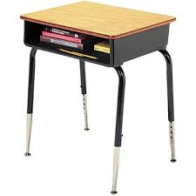
practice
A student exerts a force of 4 N to move her desk forward 0.75 m. How much work is done?

Slide 19
Practice
A rock climber wears a 7.5 kg backpack while scaling a cliff. After 30.0 min, the climber is 8.2 m above the starting point.
How much work does the climber do on the backpack?
If the climber weighs 645N, how much work is done to lift the climber and the backpack?

Slide 20
Practice
Together two students exert a force of 825N in pushing a car a distance of 35m. How much work do the students do on the car?
If their force is doubled, how much work must the do on the car to push it the same distance?

Slide 21
Starter 1/8/19 pg. 43-44 Objective: I will demonstrate how mass affects the amount of work in a system by completing a work lab.
In what units is work measured?
What is the minimum amount of work done by a hydraulic lift to raise a 15kg aluminum block 2.0 m vertically?
What is the best evidence that work has been done on or by an object?
The energy of the object has changed

Slide 22
Work Mini LAB Objective: I will demonstrate how mass affects the amount of work in a system by completing a work lab.
Get into groups of no more than 2. We will now complete a lab.
Before heading out, copy the following masses into your data chart:
Textbook:
Ball:
Glue Stick:
Bean Bag:
Mass: this one is written on the mass itself…
Each group will need ONE phone in order to time the lab.

Slide 23
Daily Reflection
On the page 43-44 complete 2-3 sentences explaining what you learned today.

Slide 24
Simple Machines Vocabulary
Screw: An inclined plane wrapped around a cylinder, tip is tiny wedge
Lever: A bar that rests on a fixed support called a fulcrum
Pulley: Rope or chain wrapped around a grooved wheel
Wedge: One or more inclined planes
Wheel and Axle: Made up of two circular objects of different sizes. Large=wheel, small=axle
Inclined Plane: Slanted, flat surface such as a ramp

