Slide 1
PHONES UP!!
Objective: I will demonstrate how mass affects the amount of work in a system by completing work practice.
Starter 1/9/19
What is the equation for work?
How can you decrease the amount of work being done?

Slide 2
Phones Up
Objective: I will determine how work and power are related by completing power calculations and practice problems.

Slide 3
Starter Pg. 43-44
The third floor of a house is 10m above street level. How much work must a pulley system do to lift a 100kg piano to the third floor?
Complete a free body diagram showing all of the forces acting on the piano as it is lifted to the third floor.
Amy does 198J of work lifting herself 0.5m. What is Amy’s mass?

Slide 4
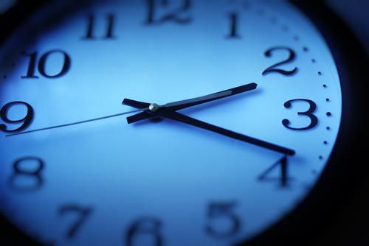
Doing work is not enough!
How much work would be required to move (push) a stack of 5 books that are 3kg each across the room 10m at one time?
How much work would be required to move (push) each of the 5 books at 3kg each across the room 10m individually (one at a time)?
Does it matter how long it takes to do the work?
NO!!

Slide 5
Power Defined
Power is defined as the rate at which work is done.
TIME MATTERS!!!

Slide 6
Power Equation
$$Power= \frac{Work}{time}$$
AKA
$$P=\frac{W}{t}$$
Units: Joules / second = WATT (W)

Slide 7
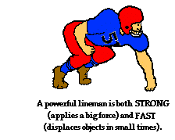
Would it take longer to move an entire stack of books or to move each book individually across the room?
More work means more power. They are proportional.
W = P· t
More time means less power.
They are inversely proportional.
t = W
P

Slide 8
Steps to solving a Power Problem
1. Find the force (if not given):
F = m· g
2. Find work:
W = F · d
3. Find power:

Slide 9
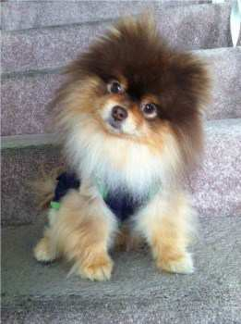
Steps to Solving a Power Problem
How much power is exerted by Esther lifting her 2.23 kg teacup Pomeranian dog to a height of 1.5 m if it takes her 3 seconds to lift her?
1. first find the force needed to pick up the puppy:
F_{w} = mg = 2.23 · 9.8 = 21.854 N
2. find the work done:
$W=F∙d$= 21.854 · 1.5 = 32.781 J
3. find the power:
$P=\frac{W}{t}$ = $\frac{32.781}{3}$ = 10.927 W

Slide 10
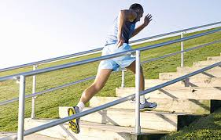
How much average power is exerted by an 80kg man running up a flight of stairs rising vertically 5m in 7 seconds?
1.
2.
3.

Slide 11
Daily Reflection
On the page 43-44 complete 2-3 sentences explaining what you learned today.

