Slide 1
BELL RINGER
Get out all of your plant notes and assignments so that they are organized. If you have any missing assignments those should be out as well.

Slide 2
How do nutrients and water enter a plant and travel to the flower tissues?
The nutrients and water enter the plant at the roots and travel up the vascular tissue through the Xylem up to the flower.

Slide 3
What is it called when plants respond to the shade or light in their environment?
Phototropism

Slide 4
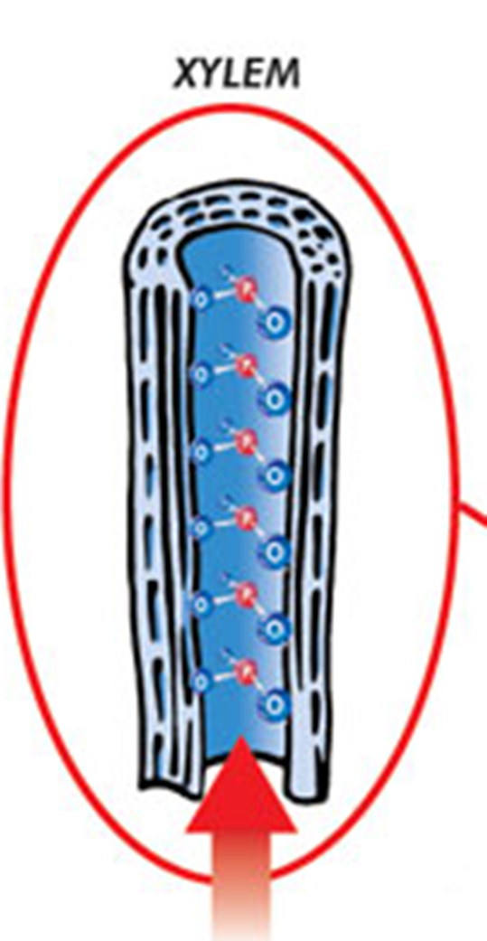
What is the function of the XYLEM?
Transport water and minerals up the stem that are absorbed in the leaves

Slide 5
What are the four biomolecules?
What are their functions?
Carbohydrates
Lipids
Protein
Nucleic Acids
-CHO-1:2:1- energy (glucose) -CHO-long term energy- cell membranes
-CHON- enzymes-structural molecules -CHONP- DNA- genetic info

Slide 6
How are Photosynthesis and Cellular respiration different in how energy is obtained?
The energy in photosynthesis comes from the sun while the energy in respiration comes from glucose.

Slide 7
What body systems in humans are similar in function to the epidermis and stomata in plants.
Integumentary and respiratory

Slide 8
What are the characteristics of the plant kingdom?
Eukaryote
Autotrophic
Multicellular
Organ systems

Slide 9
What are the characteristics of the animal kingdom?
Eukaryotic
Multicellular
Organ systems
Heterotrophic

Slide 10
What are the characteristics of prokaryotes?
Unicellular
Auto and heterotrophic
No organelles

Slide 11
How do the plant systems work together to transport nutrients into and out of the plant?
Roots absorb water and minerals and move them up the stem through the xylem, while the phloem in the stem moves food produced in the leaves down to the roots.

Slide 12
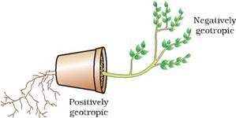
What is a geotropism?
Response to gravity

Slide 13
When photosynthesis and cellular respiration are balanced what happens to the amount of reactants and products in each?
They are equal

Slide 14
If a cell is placed in a isotonic environment where will the water move?
In and out equally

Slide 15
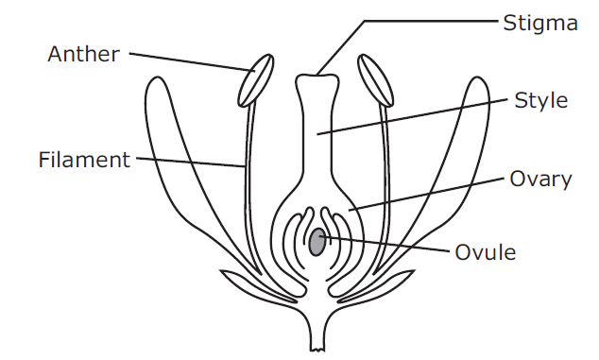
What happens when a plant is self fertilized? Trace the path of the pollen to fertilization.
the pollen is released from the anther and is transferred to the stigma. A pollen tube forms and grows through the style. The pollen tube reaches the ovule within the ovary, where the sperm fertilizes the egg.

Slide 16
Trace the path or water absorption to transpiration.
Water is absorbed through the roots system. Then transported through the shoot system by vascular tissue and stomata in the leaf tissue

Slide 17
If a cell is placed in a heterotrophic environment where will the water move?
Out of the cell

Slide 18
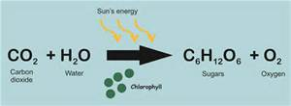
What two molecules produce glucose in photosynthesis?
Glucose is produced from CO₂ and H₂O.

Slide 19
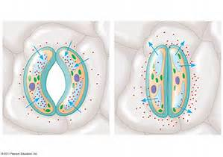
Under what environmental conditions would the stomata of a plant be closed?
when there is little water available, drought

Slide 20
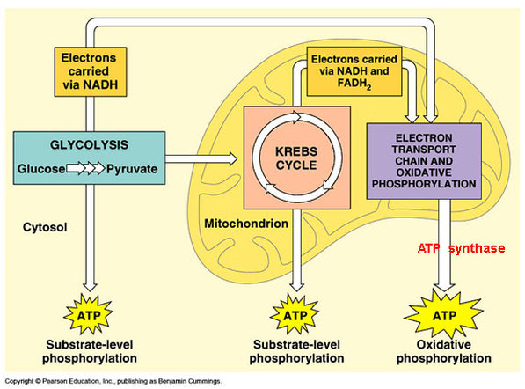
How much ATP is produced in aerobic respiration?
36 to 38 ATP

Slide 21
How is the energy from sunlight converted into ATP in the mitochondria? Describe the process.
Sun energy is converted into glucose in photosynthesis then in respiration the glucose is converted into ATP and the energy is stored in the phosphate bonds.

Slide 22
If a cell is placed into a hypotonic solution where will the water move?
Into the cell

Slide 23
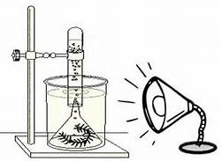
How would you increase the output of products in photosynthesis?
Increase the amount of reactants input. Light, CO₂ or water

Slide 24
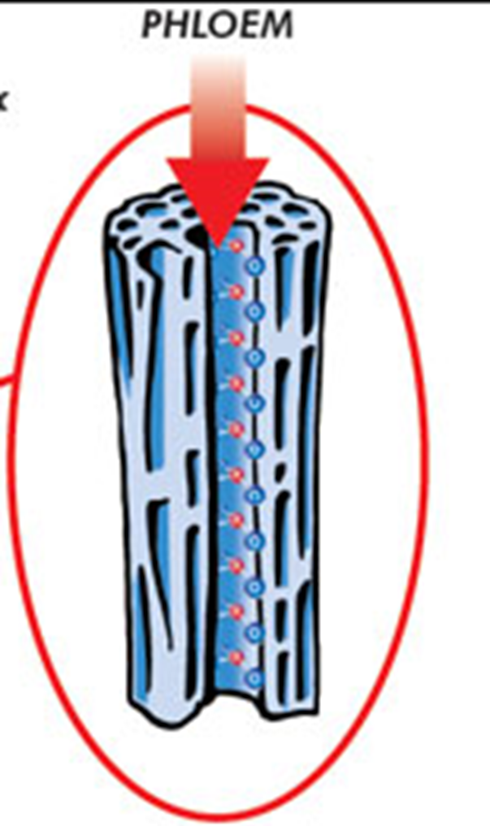
What is the phloem responsible for in plants?
Transport of food

Slide 25
What body systems work together to allow an animal to feel and react to their environment?
Nervous and muscular

Slide 26
How do the systems in a plant compare to the organ systems in an animal?
Similar functions

Slide 27
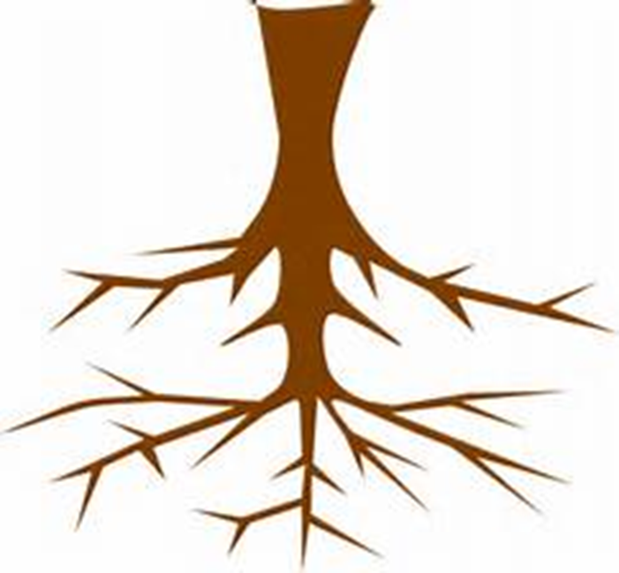
What is the function of the roots in plants?
Act as an anchor, absorbs water and nutrients, and stores food

Slide 28
What is the function of the roots, xylem and phloem?
Transport materails

Slide 29
What structures do a virus and bacteria have in common?
Nucleic Acid

